Slide 1



Project
Corporate Risk Management
Siddhesh Mahadik

Slide 2
Index
o1.
Standard Deviation Calculation
o2.
Revenue Analysis
o3.
Sponsorship
o4.

Slide 3


Introduction
Founded in 1878, Manchester United Football Club is a global sports icon based in Old Trafford, Greater Manchester. Renowned for its rich history, passionate fanbase, and unparalleled success on the field, the club has become a symbol of excellence in football and a benchmark for sports business operations.
This presentation delves into Manchester United's financial performance, using historical data to evaluate key trends and assess its strategies for sustainable growth in a highly competitive industry.

Slide 4
Key Highlights
Sporting Achievements
20 English league titles, 12 FA Cups, and 3 UEFA Champions League trophies.
Known for fostering legendary players and managers, including Sir Alex Ferguson and Cristiano Ronaldo.
Global Commercial Presence
One of the highest revenue-generating football clubs worldwide.
Significant income from matchday revenue, broadcasting rights, and global sponsorship deals.
Financial Overview:
Detailed financial analysis reveals trends in gross profit, revenue, and operating expenses.
Notable challenges include rising operational costs and fluctuating profitability in recent years, as shown in the provided dataset.

Slide 5
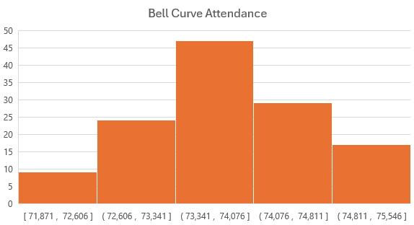
Standard Deviation Computation
Distribution Shape:
The graph resembles a bell curve, indicating a normal distribution of attendance values.
Most matches have attendance clustered between 73,341 and 74,076.
High Consistency:
The small standard deviation suggests consistent attendance across matches, likely due to strong fan loyalty and consistent ticket demand.
Growth Potential:
Attendance already near capacity for most matches.
Revenue opportunities lie in strategies like dynamic pricing or premium seating options.
Key Statistics
Average Attendance | 73,798
Standard Deviation (in nos.) | 785
Standard Deviation (in %) | 1.06%

Slide 6
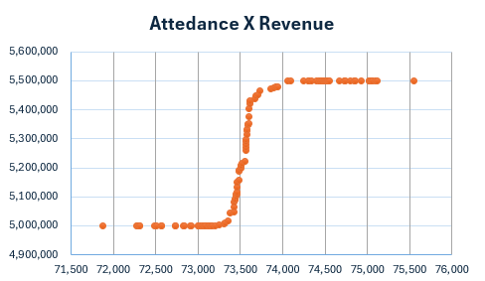
Standard Deviation Computation
Revenue Plateau:
Revenue increases with attendance but stabilizes at ~5,500,000 after 73,500 attendees.
This suggests a possible stadium capacity or ticket price limitation.
Linear Growth:
Below ~73,000 attendees, revenue shows steady linear growth, reflecting proportional ticket sales.
Optimization Potential:
Revenue growth is constrained by attendance limits, indicating potential for optimization through:
Dynamic pricing.
Additional revenue streams (e.g., premium seating or merchandise).

Slide 7


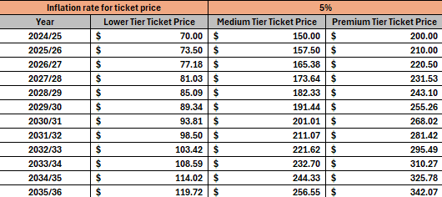
Match Day Revenue
Insights:
Steady Revenue Growth:
Ticket prices across all tiers will grow by 5% annually, with Premium Tier tickets reaching $342.07 by 2035/36.
The increasing prices will significantly enhance revenue, assuming stable occupancy rates.
Occupancy Sensitivity:
Slightly reduced occupancy rates for Medium (99%) and Premium (97%) Tiers may limit revenue growth potential, especially for high-priced seats.
Match Count Impact:
With 27 matches annually, consistent ticket price inflation ensures compounding revenue growth over time.

Slide 8
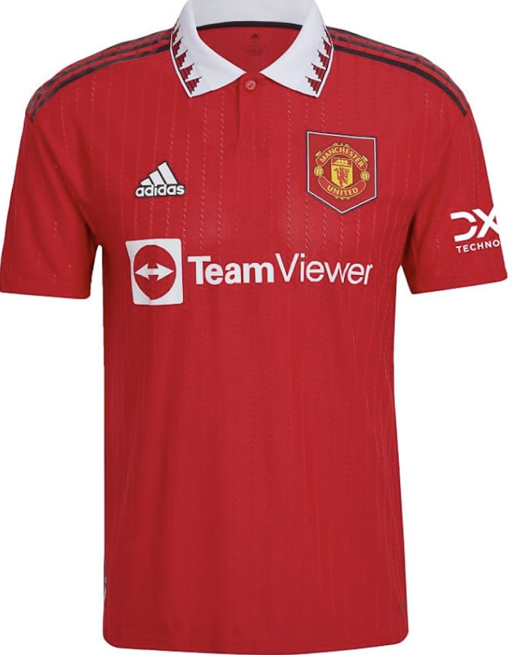
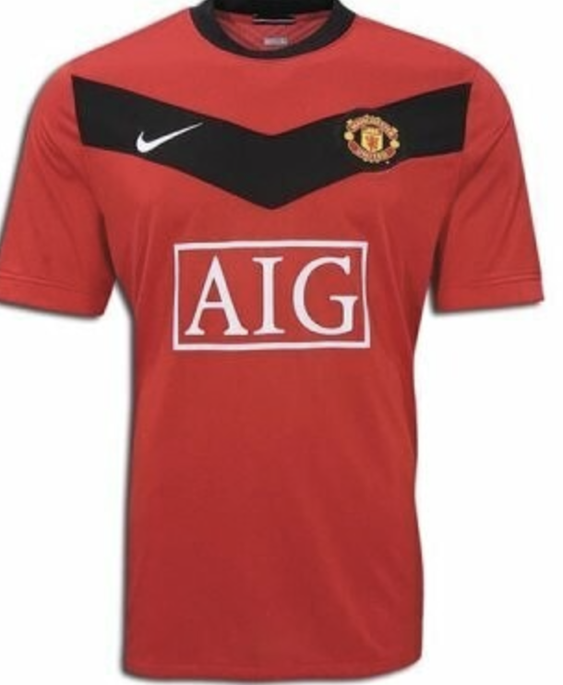
Sponsorship Revenue
Manchester United, one of the world's most popular and commercially successful football clubs, has had a rich history of partnerships and sponsorships that have significantly contributed to its global brand and financial success. The club's sponsorship agreements encompass a range of categories, including kit manufacturers, shirt sponsors, and numerous commercial partners across various industries.
Kit Manufacturer Sponsorship
Adidas: Since 2015, Manchester United has been in a high-profile partnership with Adidas, valued at approximately £750 million over ten years, making it one of the most lucrative kit deals in sports.
Previous Partners: Before Adidas, Nike, and earlier Umbro, were the kit manufacturers, emphasizing the club's long-standing appeal to major apparel brands.
Shirt Sponsorship
Chevrolet and TeamViewer: The club’s shirts have featured major sponsors like Chevrolet and more recently TeamViewer, showcasing the club's global marketing reach.
Qualcomm Snapdragon: The latest significant deal is with Qualcomm’s Snapdragon brand, extending their partnership through 2029.
Training Kit and Other Sponsorships
AON: Besides being a past shirt sponsor, AON secured naming rights to Manchester United's training complex.
DHL: Previously sponsored the training kit, setting a precedent for non-gamewear sponsorships.

Slide 9
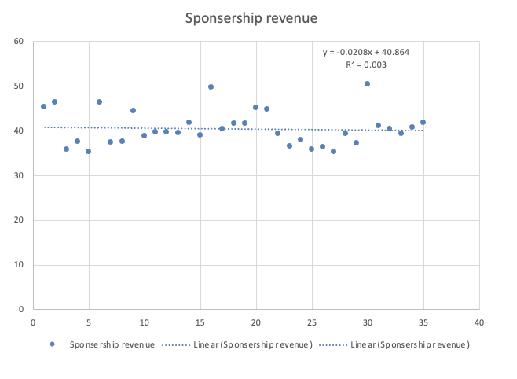
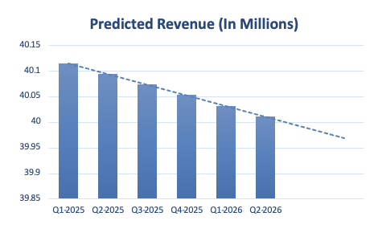
Summary of Sponsorship Revenue Analysis
This analysis focused on understanding trends in Manchester United's sponsorship revenue over 44 quarters, culminating in a predictive model for the next 8 quarters. After conducting a box plot analysis, outliers were removed to refine the dataset to 35 observations, ensuring more reliable insights.
Analytical Approach:
Data Cleaning: Utilized box plot analysis to identify and remove outliers, refining the dataset for greater accuracy in trend analysis.
Trend Analysis: A linear regression model was applied to the cleaned data, plotting sponsorship revenue against time to detect trends.
Results:
The regression equation derived from the analysis was y=−0.0028x+40.864y = -0.0028x + 40.864y=−0.0028x+40.864, with an R2R^2R2 value of 0.003. This suggests a marginal negative trend in sponsorship revenue, although the extremely low R2R^2R2 value indicates that the time variable alone provides minimal explanatory power regarding revenue fluctuations.
Predictive Analysis:
Based on the existing trend, sponsorship revenue predictions were extended for the upcoming 8 quarters. Given the low explanatory power of the current model, these forecasts should be interpreted with caution.

Slide 10
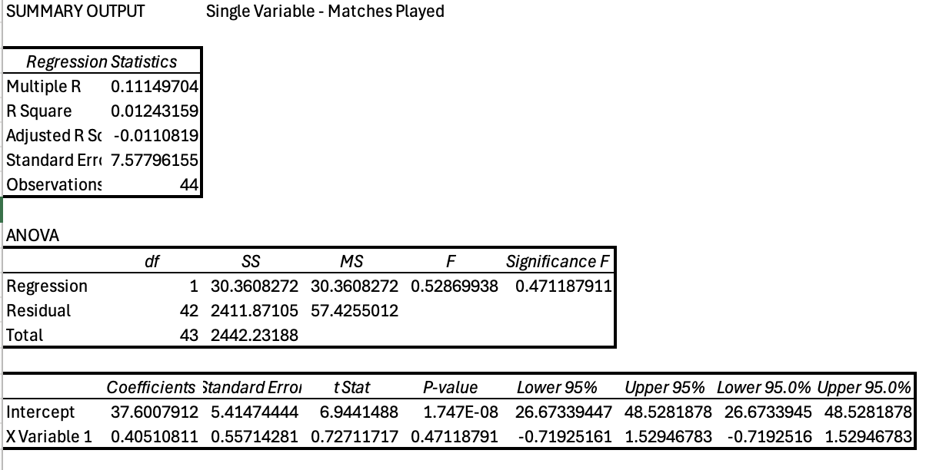
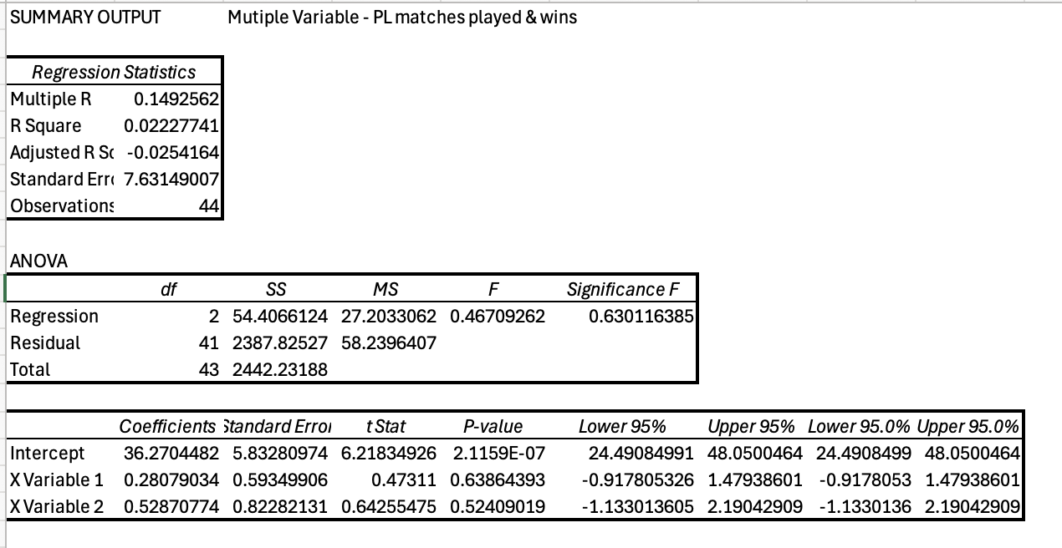
Overview of Regression Analysis
Objective: Examine the predictive power of Premier League matches played and wins on sponsorship revenue.
Methods: Utilized single-variable and multi-variable linear regression models.
Single Variable Regression Results
Model Description: Analysis using only Premier League matches played as the predictor.
Key Statistics:
R-Squared: 0.0124 - Indicates that only 1.24% of the variance in sponsorship revenue is explained by the model.
Adjusted R-Squared: -0.011 - Suggests no meaningful variance explained; model performs poorly.
Significance of F: 0.4718 - The model is not statistically significant.
Multiple Variable Regression Results
Model Description: Analysis using both Premier League matches played and wins as predictors.
Key Statistics:
R-Squared: 0.0223 - Indicates that only 2.23% of the variance in sponsorship revenue is explained.
Adjusted R-Squared: -0.0254 - Adjusted for the number of predictors, indicating a lack of fit.
Significance of F: 0.6301 - The model is not statistically significant.

Slide 11
Interpretation of Results
Findings: Both models show very low R-squared values, indicating that the variables (matches played and wins) have minimal explanatory power for sponsorship revenue.
Statistical Significance: High p-values and non-significant F-tests suggest that the models do not provide a reliable basis for predicting sponsorship revenue.
Conclusions:
Premier League performance metrics such as matches played and wins are not strong predictors of sponsorship revenue for Manchester United.
The lack of model fit suggests the need to consider other variables that might influence sponsorship revenue more significantly.

Slide 12
Forecasting Future Sponsorship Revenue Using Monte Carlo Simulations
Introduction to Forecasted Revenue:
"Using Monte Carlo simulations, we've projected the potential sponsorship revenue for Manchester United over the next eight quarters. To conduct the Monte Carlo simulations, we have used historical sponsorship revenue data as a base. Then applied random fluctuations, based on historical variances, to generate 200,000 of possible scenarios for future revenues.
Forecasted Revenue:
"This table summarizes the forecasted sponsorship revenue from Q1-2025 through Q4-2026. The figures reflect a composite view based on multiple simulation runs, showcasing the expected revenue in millions of pounds."
Highlight Key Figures: "Notice the gradual increase in forecasted revenue, starting at £40.3 million in Q1-2025 and reaching a high of £57.35 million by Q2-2026.”
Bar Chart Analysis:
"The bar chart visually represents the forecasted revenue across the quarters. The upward trend shown by the bars is further emphasized by the dotted line, which represents the linear progression of the revenue forecasts.
Interpretation:
Each bar corresponds to a quarter's forecasted revenue, illustrating the growth trajectory based on our simulations. This visual helps in easily identifying growth trends and planning accordingly.
Forecasted Revenue
Quarter/Year | Sponsership Reveune (In Millions)
Q1-2025 | 40.3
Q2-2025 | 44.52
Q3-2025 | 45.039
Q4-2025 | 50.516
Q1-2026 | 51.34
Q2-2026 | 57.35
Q3-2026 | 52.95
Q4-2026 | 55.78

Slide 13
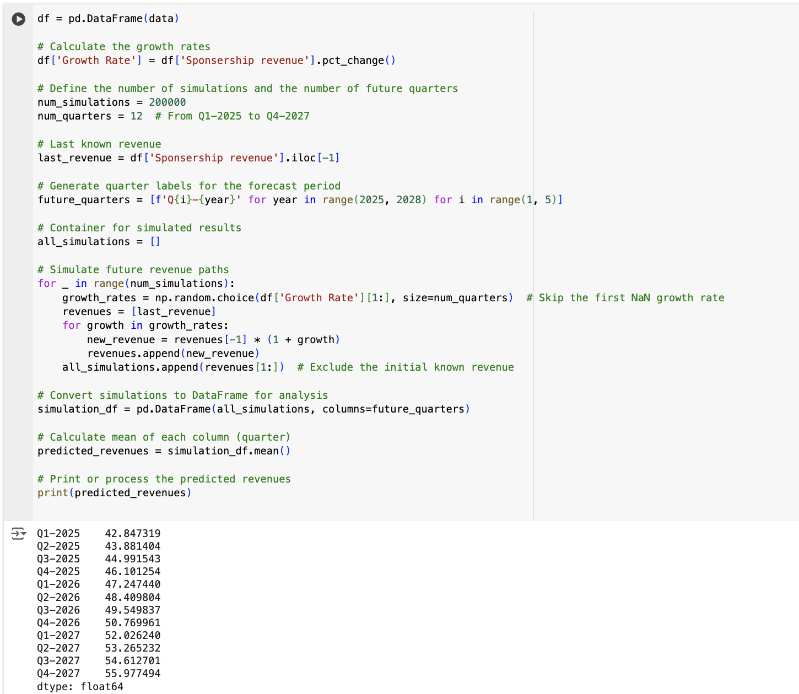
Monte Carlo Simulation Results for Forecasting Sponsorship Revenue- Using Python
Introduction to Simulation Analysis
"We employed Monte Carlo simulations to forecast future sponsorship revenue for Manchester United, utilizing both Excel and Python to ensure robustness and accuracy in our predictive models.”
Methodology Overview
"In our analysis, over 200,000 simulations were run using Python, complementing our initial Excel-based simulations. This approach allowed us to incorporate variability and probabilistic outcomes, capturing a broad spectrum of potential future revenues.”
Results Summary
"The simulation results project a consistent upward trend in sponsorship revenue from Q1-2025 through Q4-2027. Here are some key projected revenues for upcoming quarters:
Q1-2025: £42.85 million
Q2-2025: £43.88 million
Q4-2026: £50.77 million
Q4-2027: £55.98 million
These projections were corroborated by similar analysis done in Excel, enhancing confidence in the accuracy and reliability of our forecasts."

Slide 14
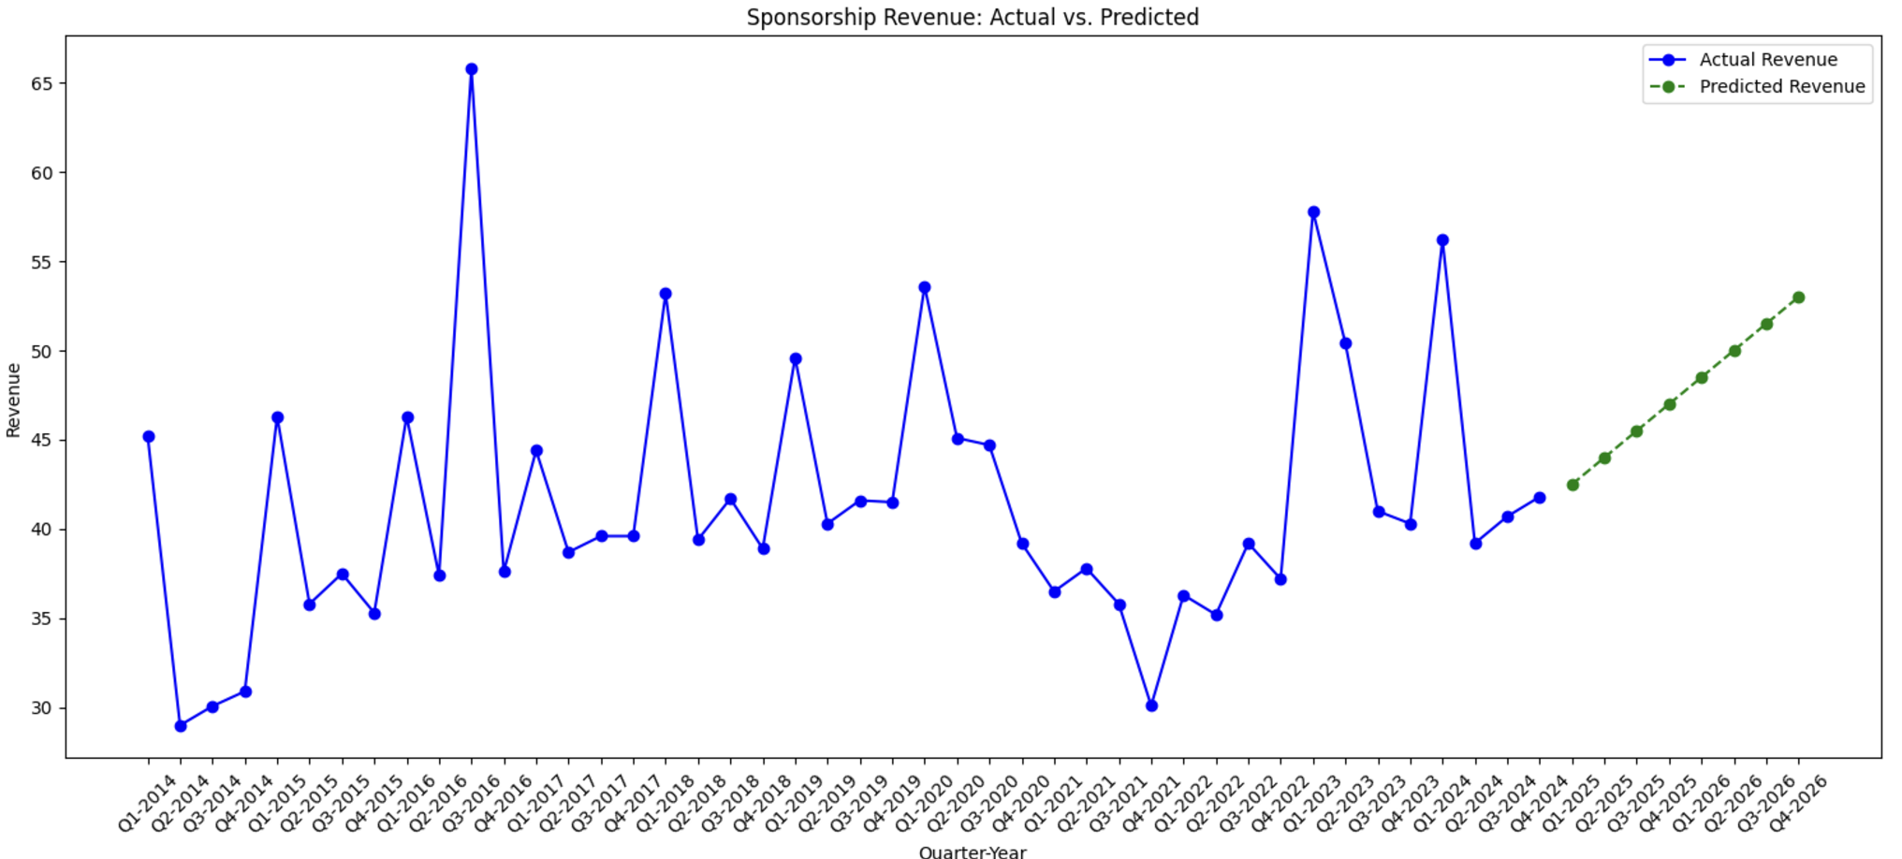
Strategic Implications of Simulation Results
Graphical Representation
"The accompanying chart displays the actual versus predicted sponsorship revenues. The blue line represents actual past revenues, and the green dotted line indicates the predicted future revenues based on our simulations.”
Comparison and Validation
"The close alignment between the Excel and Python simulation outputs validates our modeling approach and confirms the robustness of our predictive analytics.”
Conclusion and Implications
"The Monte Carlo simulations provide us with a comprehensive view of potential financial outcomes, empowering strategic decision-making with respect to sponsorship deals and financial planning."
"Given the validated results, we recommend continued use of this modeling technique to refine our financial forecasts and support strategic initiatives."

Slide 15
Retail, Merchandise, Aparel and products licensing
The revenue prediction model was developed using historical data and a polynomial trendline equation y=0.0866x2+0.1009x+24.976y, with an R^2 of 0.9802, meaning it explains 98% of revenue variability based on matches played.
I simulated the number of matches played annually, assuming variability between 28 and 30 matches to reflect real-world conditions like scheduling and performance, using Excel’s NORM.INV functions.
For each simulated number of matches, I used the trendline equation to project annual revenues, showing that 28 matches generate ~92M, while 30 matches generate ~106M.
Revenues grow predictably with more matches, with each additional match increasing revenue by approximately 5.5M, demonstrating how sensitive revenue is to match counts.

Slide 16
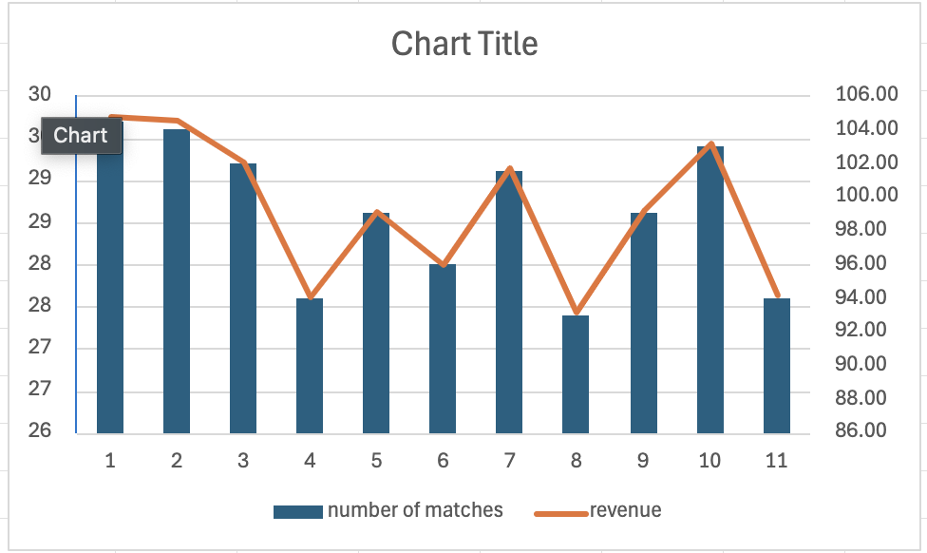
Details of Simulation2
Revenue peaks when 30 matches are played, as seen in year 10 with 106M, while minor dips occur with 28 matches, as seen in year 4 with 92M, but revenue remains stable overall.
Simulations introduced randomness, accounting for real-world uncertainties such as unexpected match cancellations or changes in performance, ensuring the model is both realistic and adaptable.
Across the simulated 11 years, average revenue is approximately 98.87M, providing a reliable benchmark for long-term planning and financial projections.

Slide 17
Retail, Merchandise, Aparel and products licensing
The model shows that revenue is robust even in less favorable years, with the range of simulated revenue staying between 92M and 106M, offering stakeholders confidence in financial stability.
Stakeholders can use this model to ensure match counts stay above 28 annually to maintain consistent revenue, with a focus on maximizing performance by scheduling up to 30 matches.

Slide 18
THANK YOU

